Slide 1

RFP Submission Guide
A step-by-step guide to submit on SmarterSelect

Slide 2
RFP Submission Links
Navigate to the SmarterSelect Portal Link for the specific proposal you intend to submit. Below are the links:
Pre-Submittal Questionnaire
CFH Request for Proposal (RFP)
Please note, these links can also be found in the RFP Packet on our website.

Slide 3
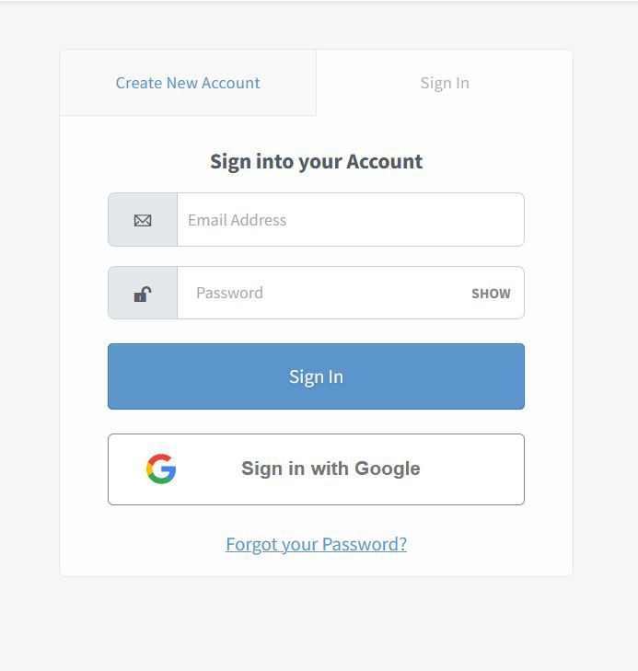
Creating an Account
The first thing you will need to do
within the Smarter Select
platform is to create
an account.
Please be sure to use an email
address that you check regularly. The email you put in the submission is the email we will use to communicate with you.

Slide 4
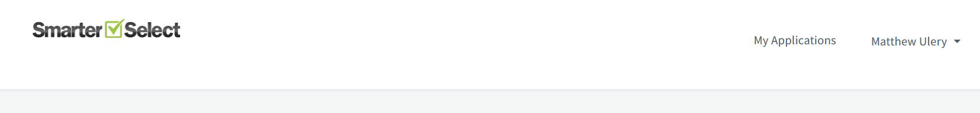
Navigation
My applications
This is where all of your active proposals will live.
Your Profile
This is where you can access your "profile" to edit your information and preferred email address

Slide 5
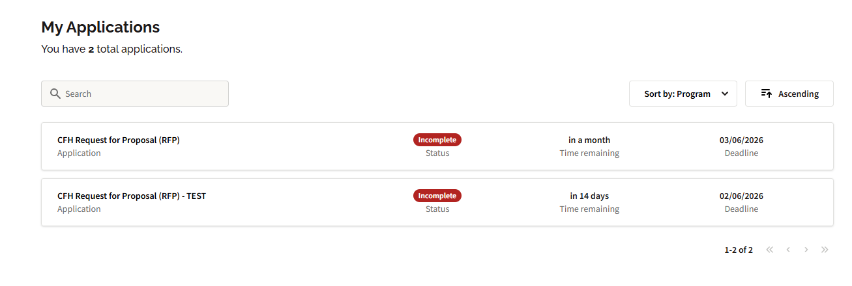
My Applications
This will house all of your proposals for the RFP.
From here you can re-open and edit any application that has not reached its deadline.

Slide 6
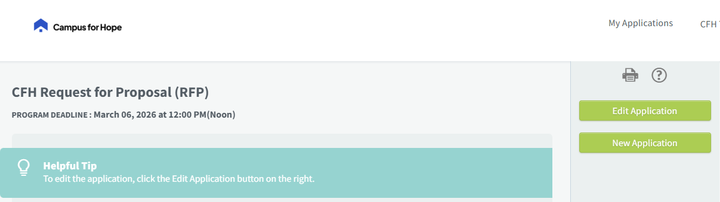
Application Tips
When you open a submission from your "My Applications" page it will open in a new window/tab. Make sure to click the "Edit Application" button to open that existing submission for editing again.
This is a great way to continue working on a submission and save your progress.

Slide 7
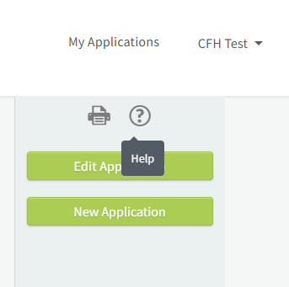
FAQ Page
You can find the FAQ page located on your submission in the upper right-hand corner, where the ? is located.
Please note: the FAQ page will be updated weekly on Friday mornings with any questions that were asked the days previous (all anonymously).

Slide 8
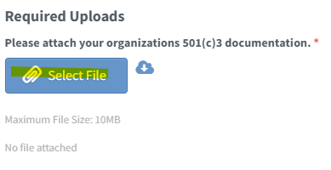
Uploading Docs
There are required uploads for all organizations (501c3 documents, 990's, etc.) and some just for the comprehensive narrative (outcomes template, budget documents, etc.).
Please note there is a 10MB maximum per upload, but you can upload multiple items.
If you have any issues, please reach out directly to RFP@campusforhope.org

Slide 9
Questions?
Please don’t hesitate to reach out directly to our team at the information below, or find us at the below times:
Information Sessions
  January 30, 2026, at 8:30AM-10AM at United Way Offices (5830 W. Flamingo Rd., Las Vegas, NV)
  February 4th at 1:00PM-2:30PM at Opportunity Village (6300 W. Oakey Blvd. Las Vegas, NV)
  February 6th at 9:00AM-10:30AM (virtual) – meeting link in packet
  February 13th at 11:00AM-12:30PM (virtual) – meeting link in packet
RFP Open Office Hours at the Community Experience Center Tuesday from 9am-12pm
Email RFP@campusforhope.org or call 702-603-1490

